Slide 1
14-UNIX
POSIX Threads
Chapter 29

Slide 2
Threads (1 of 3)
Like processes, threads are a mechanism that permit an application to perform MULTIPLE tasks concurrently (LPI – 29-1).
Think of a thread as a “procedure” that runs independently from its main program.

Slide 3
Threads (2 of 3)
Multi-threaded programs have several procedures that are able to be scheduled to run simultaneously and/or independently by the OS.
A Thread exists within a process and uses the process resources.

Slide 4
Threads (3 of 3)
Threads only duplicate the essential resources they need to be independently schedulable.
A thread will terminate if the parent process terminates.
A thread is “lightweight” because most of the overhead has already been accomplished through the creation of the process.

Slide 5
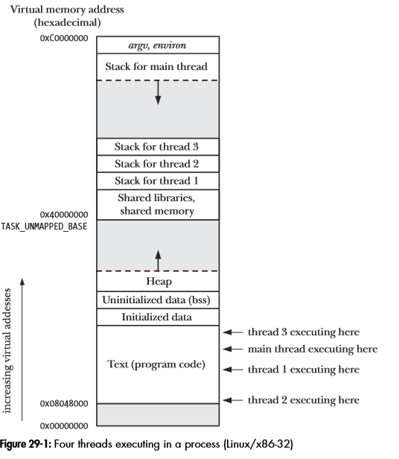
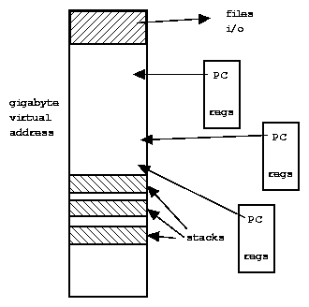
Threads
From our book TLPI Page 618
Each thread has its own stack, PC, registers
Share address space, files,…

Slide 6
POSIX Threads (PThreads)
For UNIX systems, implementations of threads that adhere to the IEEE POSIX 1003.1c standard are Pthreads.
Pthreads are C language programming types defined in the pthread.h header/include file.
How to compile:
gcc hello.c –lpthread –o hello

Slide 7
Why Use Pthreads
The primary motivation behind Pthreads is improving program performance (MAY NOT BE A BENEFIT if your system has a single processor).
Can be created with much less OS overhead.
Needs fewer system resources to run.

Slide 8
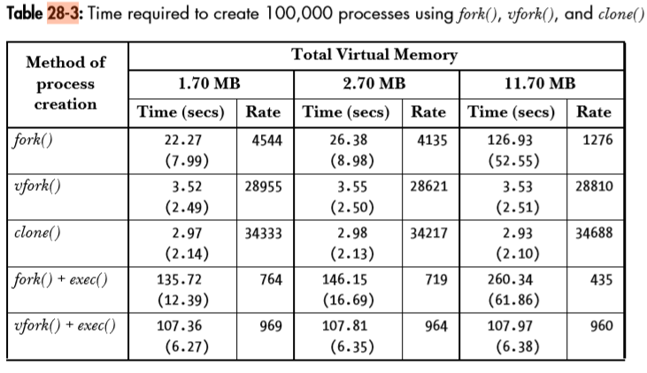
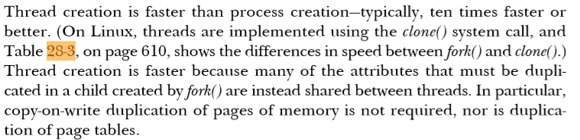
Threads (clone) vs Forks (TLPI book)

Slide 9
Designing Pthreads Programs (1 0f 2)
Pthreads are best used with programs that can be organized into discrete, independent tasks which can execute concurrently.
Example: routine 1 and routine 2 can be interchanged, interleaved and/or overlapped in real time.

Slide 10
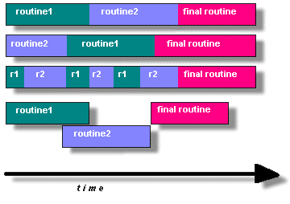
Candidates for Pthreads

Slide 11
Designing Pthreads (2 of 2)
Common models for threaded programs:
Manager/Worker: manager assigns work to other threads, the workers. Manager handles input and hands out the work to the other tasks.
Pipeline: task is broken into a series of sub-operations, each handled in series but concurrently, by a different thread.

Slide 12
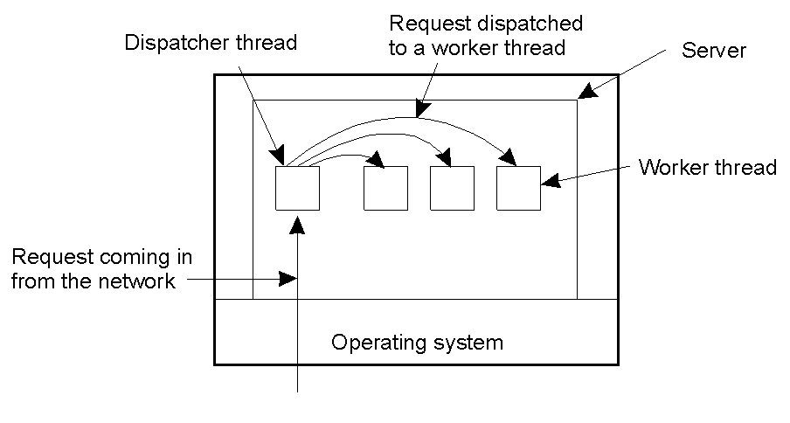
Multi-threaded Server Example
Apache web server: pool of pre-spawned worker threads
Dispatcher thread waits for requests
For each request, choose an idle worker thread
Worker thread uses blocking system calls to service web request

Slide 13
Pthread Management – Creating Threads
The main() method comprises a single, default thread.
pthread_create() creates a new thread and makes it executable.
The maximum number of threads that may be created by a process is implementation dependent.
Once created, threads are peers, and may create other threads.

Slide 14
Create Thread System Call
#include <pthread.h>
int pthread_create( pthread_t *thread,
pthread_attr_t *attr,
void *(*thread_function)(void *),
void *arg );
Returns 0 on success, or a positive error number on error.
1st arg – pointer to the variable that will hold the identifier of the created thread (like a process ID)
2nd arg – thread attributes. If null, then the thread is created with default attributes
3rd arg – pointer to the C function that the thread will execute once the thread is created
4th arg – the argument of the executed function returns 0 for success

Slide 15
Pthread Management – Terminating Threads
Several ways to terminate a thread:
The thread is complete and returns
The pthread_exit() method is called
The pthread_cancel() method is invoked
The exit() method is called
The pthread_exit() routine is called after a thread has completed its work and it no longer is required to exist.

Slide 16
Thread Termination
#include <pthread.h>
void pthread_exit (void *retval)
Retval specifies the return value for the thread.
The value pointed to by retval should not be located on the thread’s stack, since the contents of that stack become undefined on thread termination.
If the main thread calls pthread_exit() or performing a return then the other threads continue to execute.

Slide 17
Thread IDs
#include <pthread.h>
pthread_t pthread_self (void)
Returns the thread ID of the calling thread.
A thread can obtain its own ID using pthread_self()

Slide 18
Thread Joining
#include <pthread.h>
int pthread_join (pthread_t thread, void **retval)
Returns 0 on success, or a positive number on error.
The pthread_join() function waits for the thread identified by thread to terminate.

Slide 19
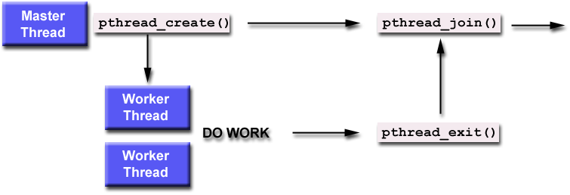
Thread Join (1 of 2)
"Joining" is one way to accomplish synchronization between threads.
The pthread_join() subroutine blocks the calling thread until the specified thread-id thread terminates.

Slide 20
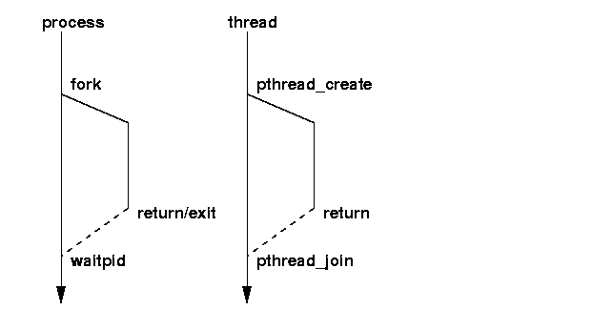
Thread Join (2 of 2) – Compared with fork/waitpid

Slide 21
Advantages of Threads
The overhead for creating a thread is significantly less than that for creating a process
Multitasking, i.e., one process serves multiple clients
Switching between threads requires the OS to do much less work than switching between processes
Sharing data between threads is easier than processes

Slide 22
Drawbacks of Threads
Not as widely available as longer established features
Writing multithreaded programs require more careful thought
More difficult to debug than single threaded programs
For single processor machines (1 CPU), creating several threads in a program may not necessarily produce an increase in performance

Slide 23
Threads and Global Variables
Threads must be very careful with access to global variables.
When we do a fork(), the child can change the global variable, and it will not cause the variable to change in the parent.
When we create a thread, a change to the global variable ripples across to the whole process and all its threads. This can cause “race conditions”.

Slide 24
Atomicity & Race Conditions
Atomicity – The kernel guarantees that all the steps in the operation of a system call are completed without being interrupted or separated by another process or thread.
Race Conditions – A situation where the result produced by two processes (or threads) operating on shared resources depends in an unexpected way on the relative order in which the processes gain access to the CPU(s).
TLPI. Section 5.1, pages 90-92

Slide 25
Sample program (thread.c)
#include <stdio.h
#include <stdlib.h>
#include <pthread.h>
#include <unistd.h>
int main(int argc, char **argv)
{ pthread_t t1;
int thread_id = 1;
if ( (pthread_create(&t1, NULL, (void *)&worker (void *), &thread_id)) != 0)
{ printf("Error creating thread\n");
exit(EXIT_FAILURE);
}
pthread_join(t1, NULL);
return (EXIT_SUCCESS);
}
void *worker(void *a) {
{ int *cnt = (int *)a;
printf("This is thread %d\n", *cnt);
pthread_exit(0);
}

Slide 26
Special directions for compiling
The use of pthread.h requires an additional flag at compile time, as it is not automatically included as are other include files.
Example:
gcc thread.c -lpthread –o thread

Slide 27
14-UNIX
POSIX Threads
The End

